Slide 1
Pitch Perfect
SIGHT-READING
Start

Slide 2

Pitch Perfect
SIGHT-READING
Start

Slide 3
Unit 1: Introduction to Treble Clef
Start

Slide 4

3:00
Start

Slide 5
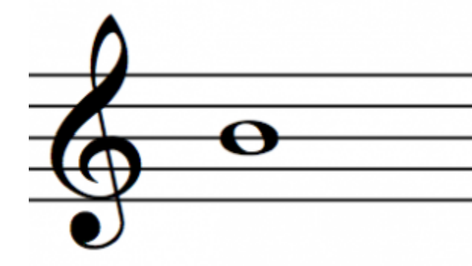
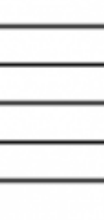


3:00
Submit
C
C#
Db
D#
Eb
F#
Gb
G#
Ab
A#
Bb
D
E
F
G
A
B

Slide 6
2:27
Submit
C
C#
Db
D#
Eb
F#
Gb
G#
Ab
A#
Bb
D
E
F
G
A
B

Slide 7
2:21
Submit
C
C#
Db
D#
Eb
F#
Gb
G#
Ab
A#
Bb
D
E
F
G
A
B

Slide 8
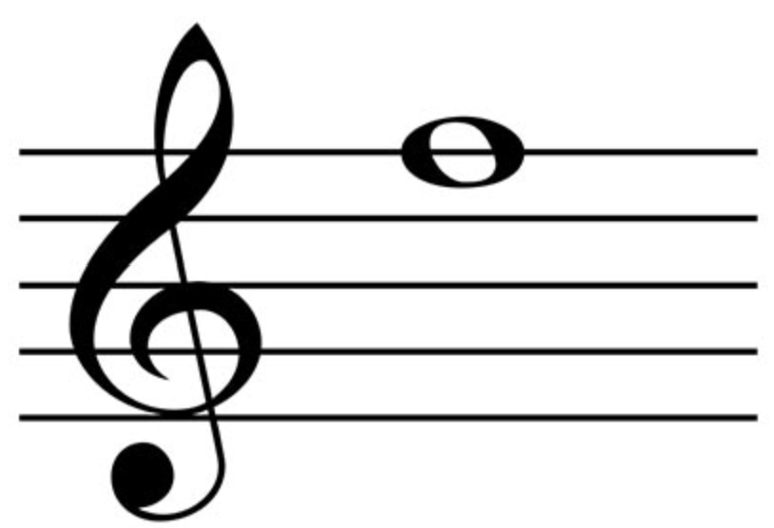
0:32
Submit
C
C#
Db
D#
Eb
F#
Gb
G#
Ab
A#
Bb
D
E
F
G
A
B

Slide 9
0:14
Submit
C
C#
Db
D#
Eb
F#
Gb
G#
Ab
A#
Bb
D
E
F
G
A
B

Slide 10
Drill Complete
1/2 50%
Back to Menu
Try Again
Review Mistakes

Slide 11
Submit
C
C#
Db
D#
Eb
F#
Gb
G#
Ab
A#
Bb
D
E
F
G
A
B

Slide 12
Submit
C
C#
Db
D#
Eb
F#
Gb
G#
Ab
A#
Bb
D
E
F
G
A
B

Slide 13
Submit
C
C#
Db
D#
Eb
F#
Gb
G#
Ab
A#
Bb
D
E
F
G
A
B

Slide 14
Submit
C
C#
Db
D#
Eb
F#
Gb
G#
Ab
A#
Bb
D
E
F
G
A
B

Slide 15
Review Complete
Back to Menu
Retry Drill

